Slide 1

Ecommerce Dataset
- P.ABIRAMI SOUNDHARYA
DATA ANALYTIC OCT BATCH 2025

Slide 2
DATA DESCRIPTION AND PREPARATION
INSIGHTS AND RECOMMENDATIONS
FORMULA AND CALCULATION
1
8
2
AGENDA
MACRO AND POWERY QUERY
7
3
PIVOT TABLE
6
4
5
DASHBOARD
SLICER AND PIVOT CHART
WHAT-IF ANALYSI AND GOAL SEEK

Slide 3

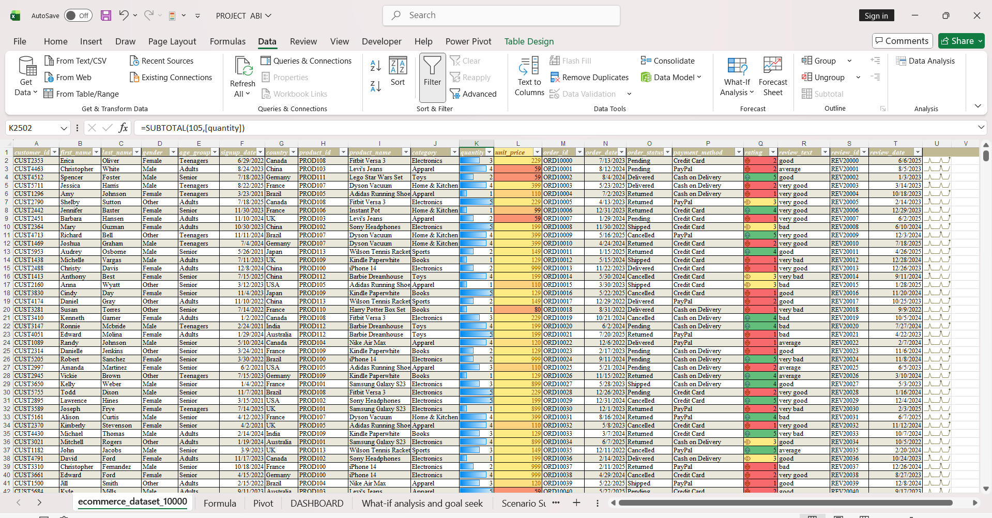
DATA DESCRIPTION
E-commerce is the buying and selling of goods and services over the internet.
This dataset contains customer, product, order, and review data from an online retail platform.
DATASET OVERVIEW- 2500 ROWS, 20 COLUMNS.
https://www.kaggle.com/datasets/nabihazahid/ecommerce-dataset-for-sql-analysis

Slide 4


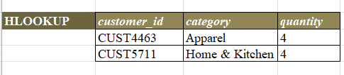
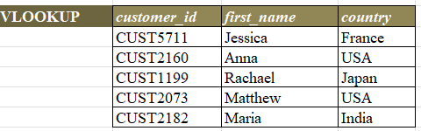
FORMULA AND CALCULATION
Calculations-
Total sales-633875
Average sales- 253.55
Formula-
HLOOKUP, VLOOKUP AND XLOOKUP

Slide 5

PIVOT TABLES
category | (All)
Row Labels | Sum of quantity | Sum of unit_price
Australia | 840 | 65980
Brazil | 754 | 63036
Canada | 691 | 58571
China | 793 | 71496
France | 819 | 75467
Germany | 603 | 48750
India | 779 | 70519
Japan | 793 | 62016
UK | 690 | 58816
USA | 681 | 59224
Grand Total | 7443 | 633875
PIVOT TABLES:
AGGREGATED BY COUNTRY, UNIT PRICE, QUANITY, PAYMENT METHOD AND YEAR.
category | (All)
Sum of rating | Column Labels
Row Labels | average | bad | good | very bad | very good | Grand Total
Australia | 165 | 199 | 126 | 148 | 189 | 827
Brazil | 143 | 146 | 168 | 146 | 205 | 808
Canada | 159 | 114 | 94 | 163 | 151 | 681
China | 155 | 194 | 147 | 163 | 157 | 816
France | 153 | 187 | 134 | 171 | 167 | 812
Germany | 110 | 135 | 137 | 112 | 145 | 639
India | 162 | 161 | 192 | 118 | 162 | 795
Japan | 140 | 132 | 193 | 125 | 157 | 747
UK | 166 | 169 | 101 | 123 | 141 | 700
USA | 102 | 113 | 140 | 152 | 129 | 636
Grand Total | 1455 | 1550 | 1432 | 1421 | 1603 | 7461
category | (All)
Count of Years (order_date) | Column Labels
Row Labels | Cash on Delivery | Credit Card | PayPal | Grand Total
Australia | 93 | 85 | 93 | 271
Brazil | 100 | 78 | 85 | 263
Canada | 70 | 77 | 80 | 227
China | 87 | 97 | 91 | 275
France | 94 | 85 | 96 | 275
Germany | 63 | 73 | 72 | 208
India | 98 | 93 | 80 | 271
Japan | 83 | 80 | 89 | 252
UK | 64 | 85 | 83 | 232
USA | 77 | 80 | 62 | 219
Grand Total | 829 | 833 | 831 | 2493

Slide 6

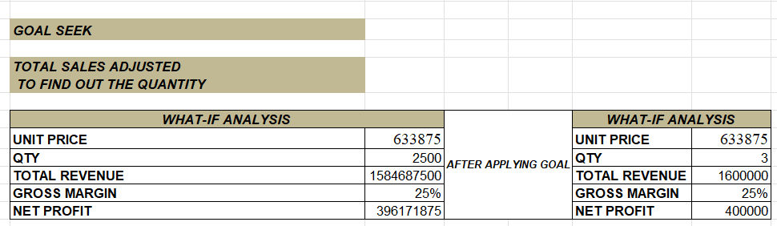
WHAT-IF ANALYSIS AND GOAL SEEK
Scenario Summary |  |  |  | CHANGING QTY FOR PROFT CHANGE
Quantity Breakdown |  | Actual Quantity | A | B | C
Changing Cells:
 | QTY | 2500 | 3000 | 4000 | 5000
Result Cells:
 | PROFIT | 396171875 | 475406250 | 633875000 | 792343750
Notes: Current Values column represents values of changing cells at
time Scenario Summary Report was created. Changing cells for each
scenario are highlighted in gray.

Slide 7


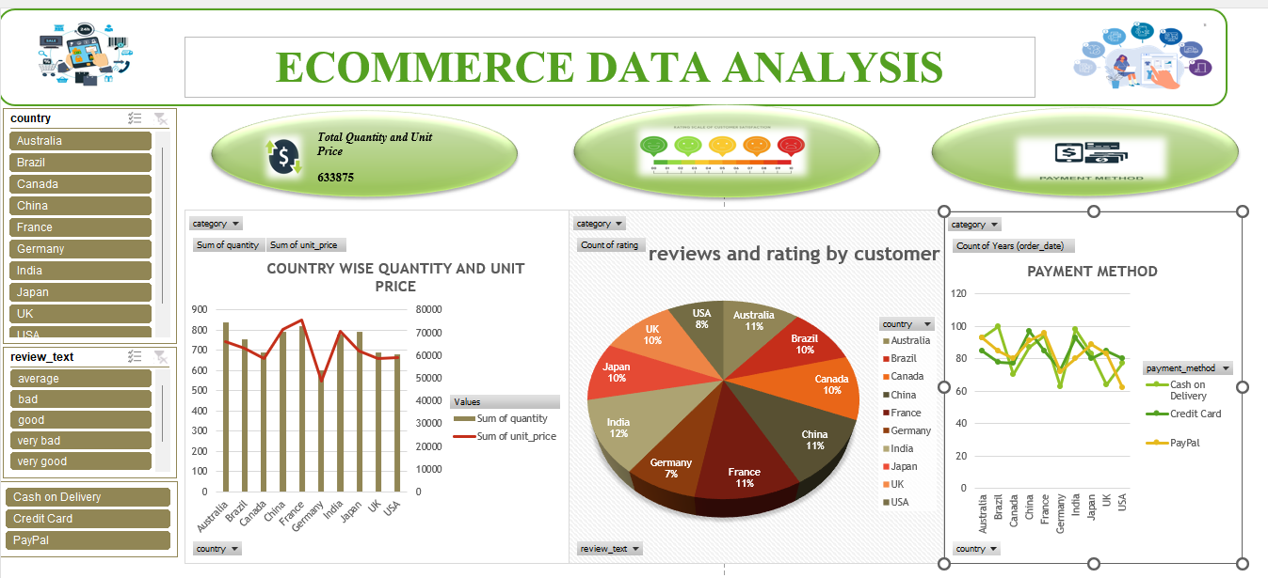
DASHBOARD OVERVIEW
TOTAL SALES FOR 2500 DATA 633875
Highest Good review country CANADA
HIGHEST PAYMENT METHOD USED IS CREDIT CARD

Slide 8

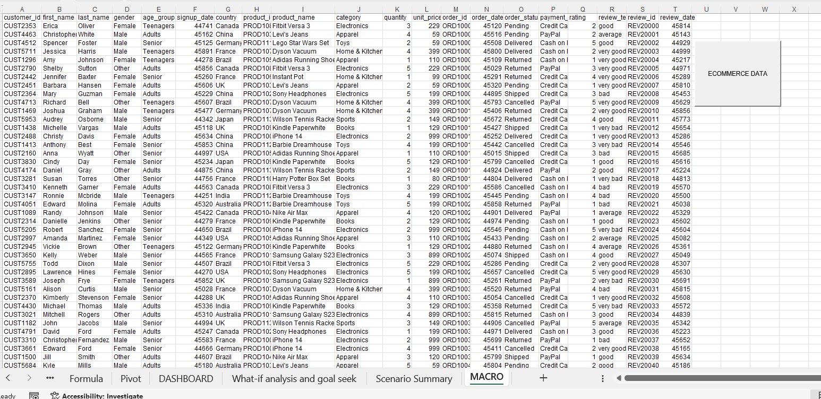
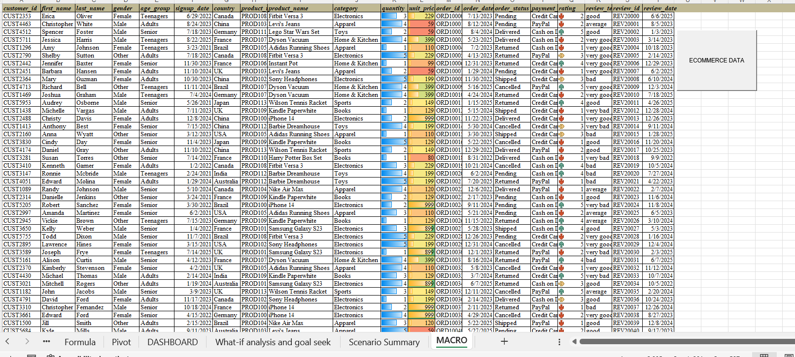
MACRO AND AUTOMATION

Slide 9


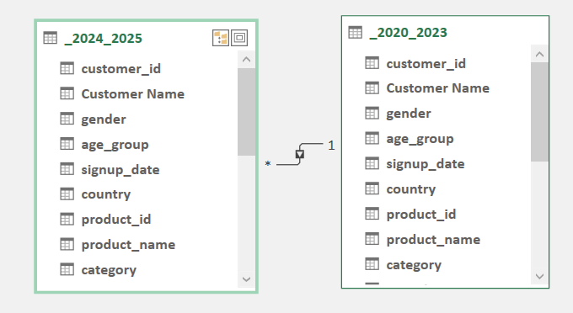
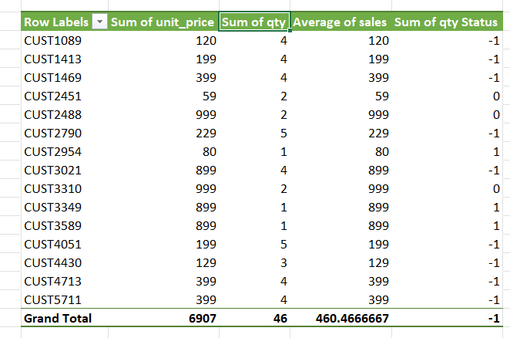
POWER PIVOT
Generated two tables 2020-2023 and 2024-2025.
Generated relationship using customer ID
Analysis total sales , sum of quantity and average sales .

Slide 10

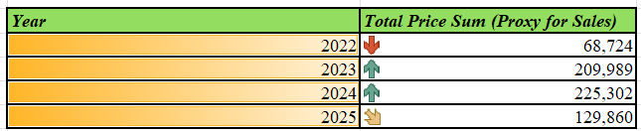
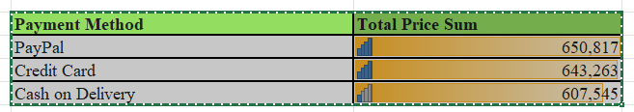
INSIGHTS AND RECOMMENDATIONS
Key Insights: Year-wise and Payment Method
Prioritize COD Risk Reduction: The previously identified high return/cancellation rate is often most severe with COD orders. Since the COD segment is not growing, focus efforts on reducing the failure rate rather than chasing more COD volume.
Future Planning (Year-wise): Allocate resources disproportionately to digital marketing and high-quality product sourcing

Slide 11



CONCLUSION
The analysis of the E-commerce dataset reveals a business in a strong growth phase, primarily driven by the successful adoption of digital payment methods (Credit Card and PayPal) in the years leading up to 2024.
To maintain and accelerate this positive trajectory, the business should prioritize incentivizing the shift to digital payments and optimizing that customer experience.

Slide 12


